Slide 1
Research Experience
Student: Chen Zilang

Slide 2
EDUCATION
South China University of Technology (SCUT) Guangzhou, China
ShienMing Wu School of Intelligent Engineering September 2022 – July 2026 (expected)
Bachelor of Engineering, GPA: 3.81/4.00 (Top 10%)
Mathematics and Statistics: Calculus (A), Probability and Statistics (B+), Linear Algebra (B-)
Computer Science: Data Structure and Algorithms (A), Machine Learning (A), Analysis and Applications of Big Data in Manufacturing (B+), Artificial Intelligence Technology and Applications (B+)
Engineering: Engineering Mechanics (B+), Thermodynamics and Fluids Mechanics (A), Introduction to Circuits(Practice) (A), Introduction to Engineering (A), Practice of Introduction to Engineering (A), Practice of Design and Manufacturing (A), Product development (A)

Slide 3
List
Analysis of Wine Quality Based on Multiple Machine Learning Methods
01
02
Embedded Smart Home Terminal Based on Lightweight Machine Learning
03
Remote-Controlled Multifunctional Ball Picking and Placing Robot
04
Biomimetic Water Surface Robot with Automatic Obstacle Avoidance
05
Real-Time Robotic Arm Motion Control Algorithm Based on Temporal Logic

Slide 4
1. Analysis of Wine Quality Based on Multiple Machine Learning Methods
Advisor: Prof. Chunyang Liao (UCLA)
Goal
Investigate how different chemical components and external factors affect wine quality in order to handle complex, non-linear relationships in a high-dimensional dataset.
Identify key correlations between wine quality and price, providing practical recommendations for wine selection.
Compare multiple basic traditional machine learning methods for predictive accuracy and interpretability, balancing model complexity with ease of deployment.

Slide 5
1. Analysis of Wine Quality Based on Multiple Machine Learning Methods
Advisor: Prof. Chunyang Liao (UCLA)
Dataset
Red Wine Dataset （Number of Instances: 1,599）
White Wine Dataset（Number of Instances: 4,898）
Number of Attributes: 12
Features: Fixed acidity, volatile acidity, citric acid, residual sugar, chlorides, free sulfur dioxide, total sulfur dioxide, density, pH, sulphates, alcohol, and quality.
Each dataset includes 11 physicochemical properties as input features and one output feature representing the wine quality score, ranging from 0 to 10, based on sensory data provided by 3 wine experts.
[1]Cortez,Paulo, Cerdeira,A., Almeida,F., Matos,T., and Reis,J.. (2009). Wine Quality. UCI Machine Learning Repository. https://doi.org/10.24432/C56S3T.

Slide 6
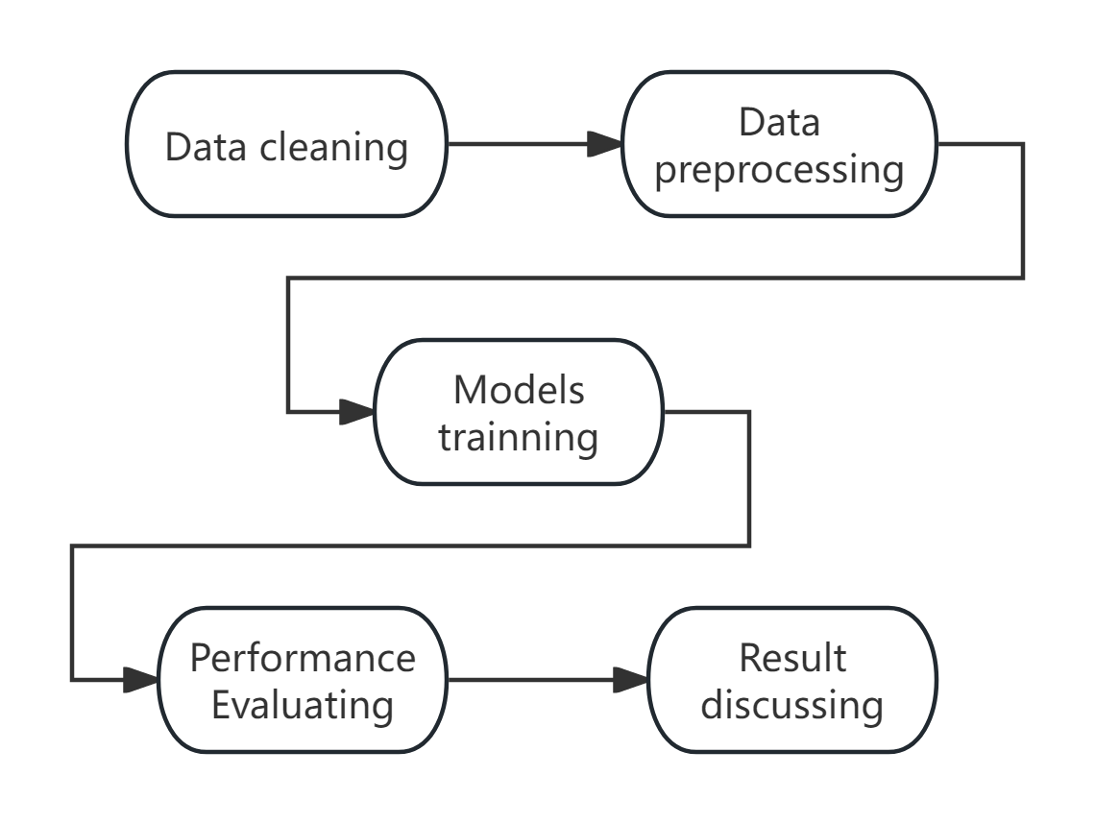
1. Analysis of Wine Quality Based on Multiple Machine Learning Methods
Advisor: Prof. Chunyang Liao (UCLA)
Bagging Methods: Decision Trees and Random Forests. 
Boosting Methods: Adaboost, Gradient Boosting Machines(GBM), and XGBoost.
Support Vector Machines (SVM), Neural Networks, K-Nearest Neighbors (KNN).
Pipeline

Slide 7
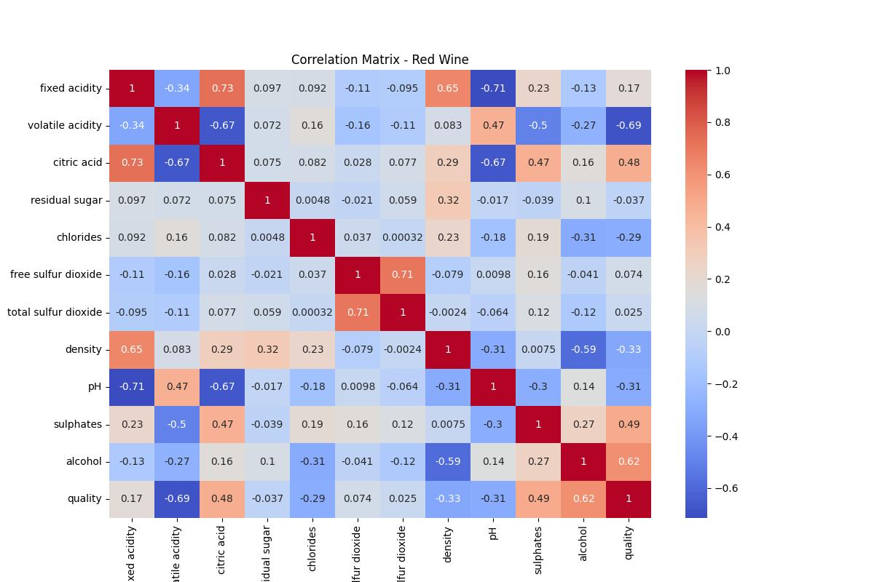
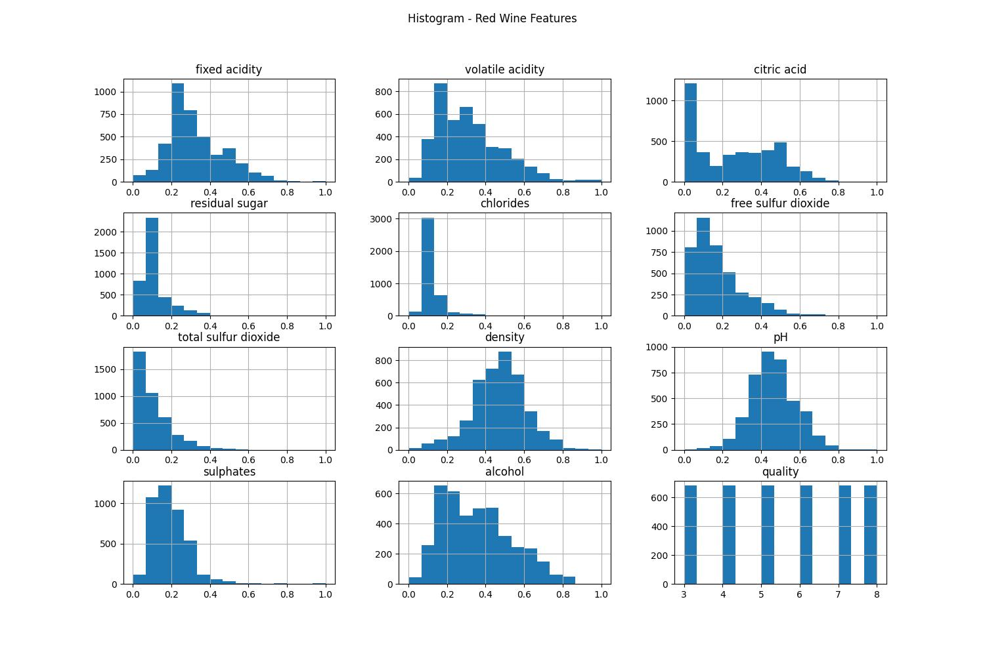
1. Analysis of Wine Quality Based on Multiple Machine Learning Methods
Advisor: Prof. Chunyang Liao (UCLA)
Correlation Matrix
Distribution Analysis

Slide 8
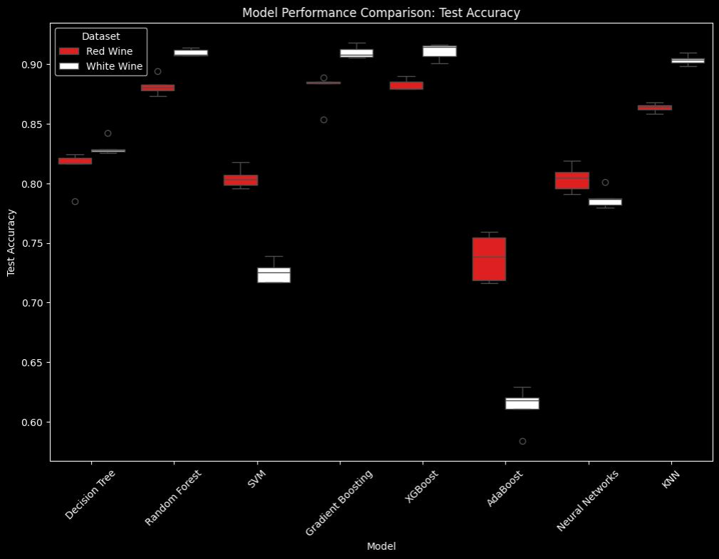
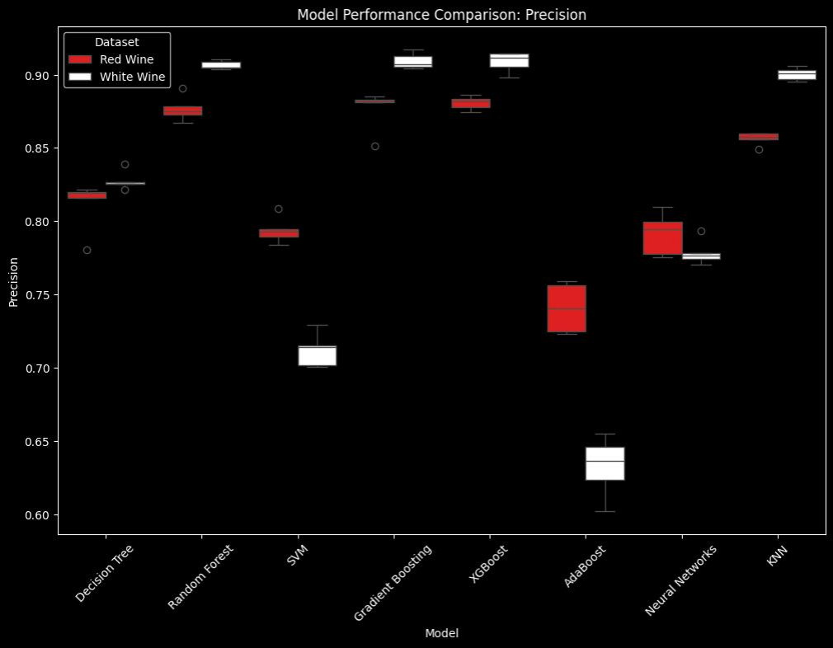
1. Analysis of Wine Quality Based on Multiple Machine Learning Methods
Advisor: Prof. Chunyang Liao (UCLA)
Top Performing Models:
1. XGBoost
2. Gradient Boosting
3. Random Forest
Accuracy Comparison
Precision Comparison

Slide 9
1. Analysis of Wine Quality Based on Multiple Machine Learning Methods
Advisor: Prof. Chunyang Liao (UCLA)
Key Outcomes
Model Performance: XGBoost, Gradient Boosting, and Random Forest consistently delivered the highest accuracy, precision, recall, and F1 scores.
Price-Quality Relationship: higher-rated wines generally command higher prices; By defining a “value metric” (wine rating divided by price), the study identified top-value wines that balance quality with affordability.
Practical Recommendations: The findings suggest that wine producers can enhance quality control and tailor improvements using advanced models. Meanwhile, consumers can benefit from reliable quality ratings to guide their purchasing choices.
Learned：Data processing， train machine learning model，evaluate the performance of the model.

Slide 10
2. Embedded Smart Home Terminal Based on Lightweight Machine Learning Advisor: Prof. Zhicong Huang (SCUT)
Goal
Develop a low-power embedded system utilizing a lightweight speech recognition model, overcoming the limitations of restricted processing and memory.
Implemented smart home control.
Integrated a large language model for online continuous conversation.

Slide 11
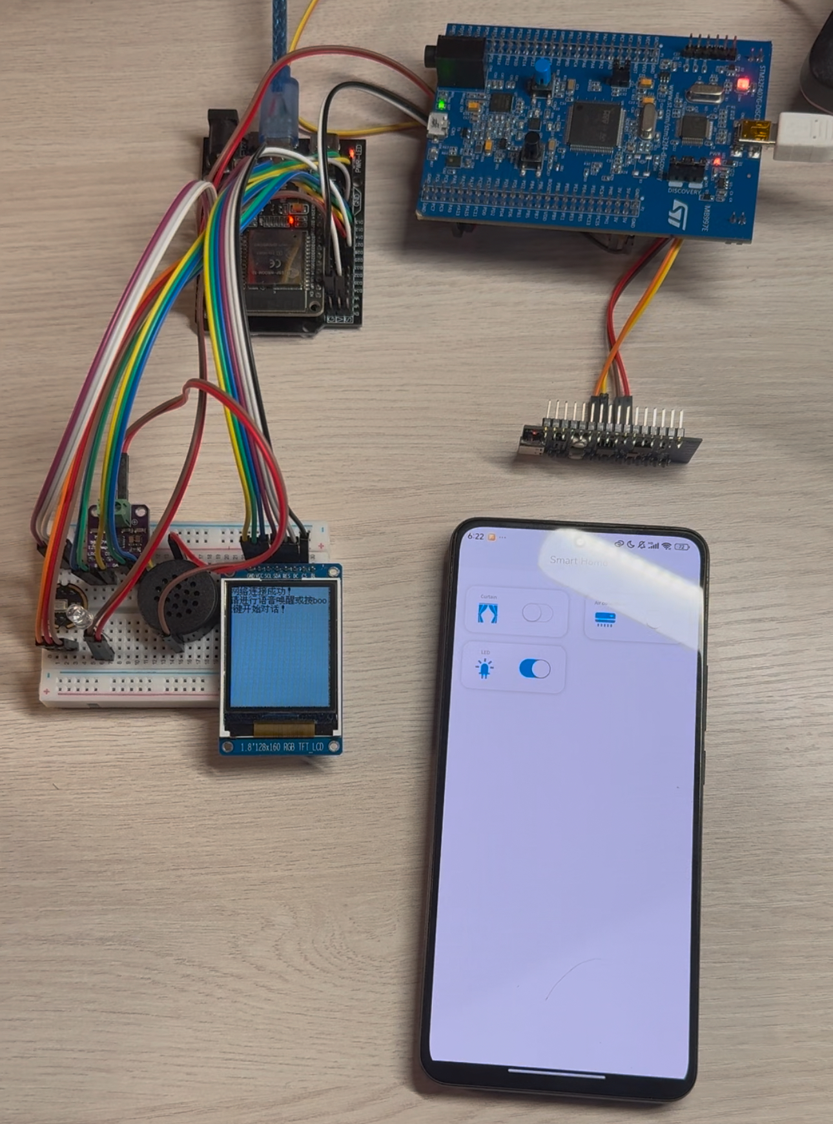
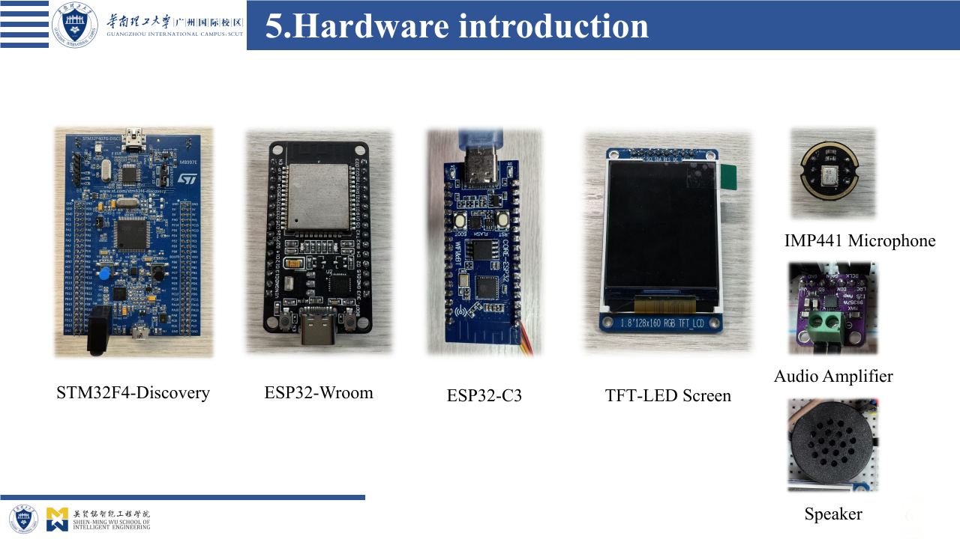
Embedded System
2. Embedded Smart Home Terminal Based on Lightweight Machine Learning Advisor: Prof. Zhicong Huang (SCUT)

Slide 12
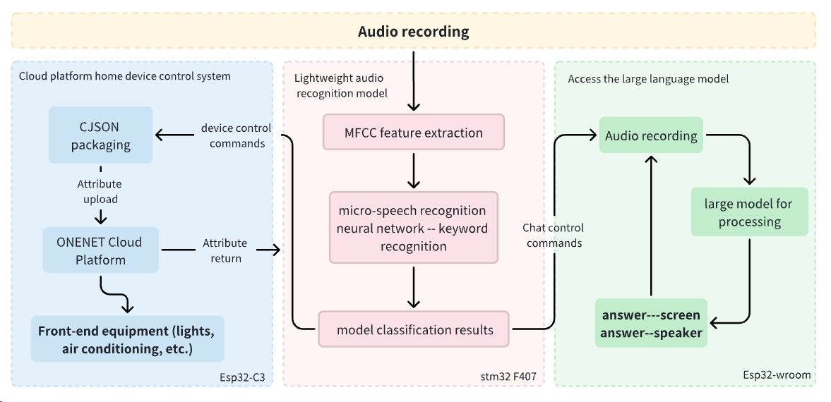
Overall Pipeline
2. Embedded Smart Home Terminal Based on Lightweight Machine Learning Advisor: Prof. Zhicong Huang (SCUT)

Slide 13
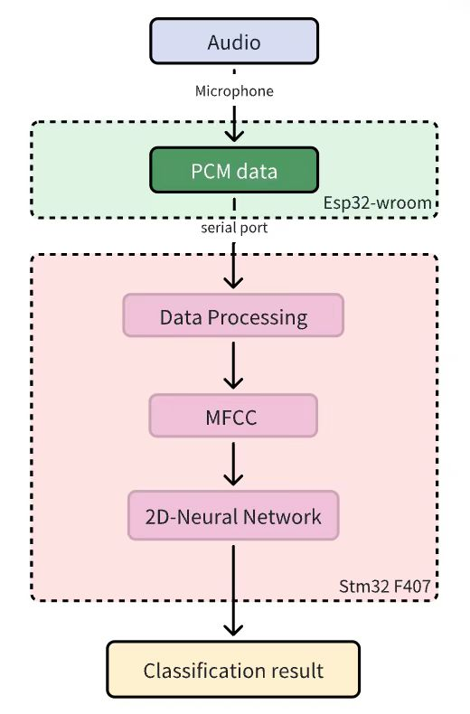
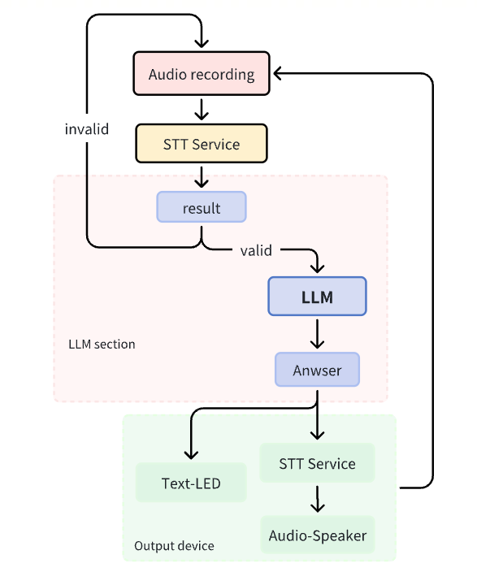
Lightweight audio reconition process& LLM
2. Embedded Smart Home Terminal Based on Lightweight Machine Learning Advisor: Prof. Zhicong Huang (SCUT)

Slide 14
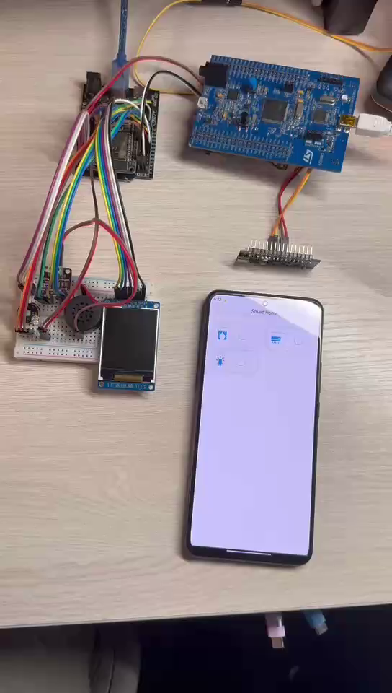
2. Embedded Smart Home Terminal Based on Lightweight Machine Learning Advisor: Prof. Zhicong Huang (SCUT)
Key Outcomes
Trained a neural network using self-recorded voice command data and deployed the model to an embedded system with TensorFlow Lite, enabling voice command recognition to control smart home devices.
Integrated a large language model into an embedded system to enable online continuous conversation and we Implemented smart home control.

Slide 15
3. Remote-Controlled Multifunctional Ball Picking and Placing Robot
Advisor: Prof. Yingjie Zhang (SCUT)
Goal
Retrieved balls from poles and placed them in designated locations within a limited time frame during a competition.
Utilize a remote controller for real-time remote operation and achieved movement based on on-site conditions.

Slide 16
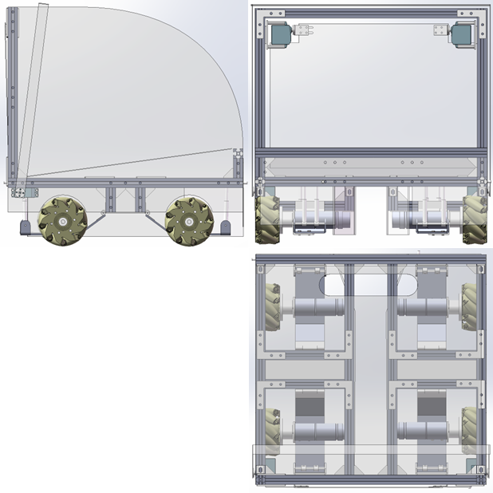
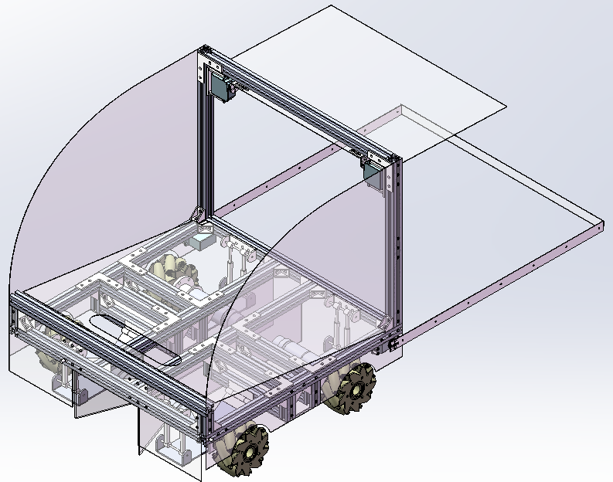
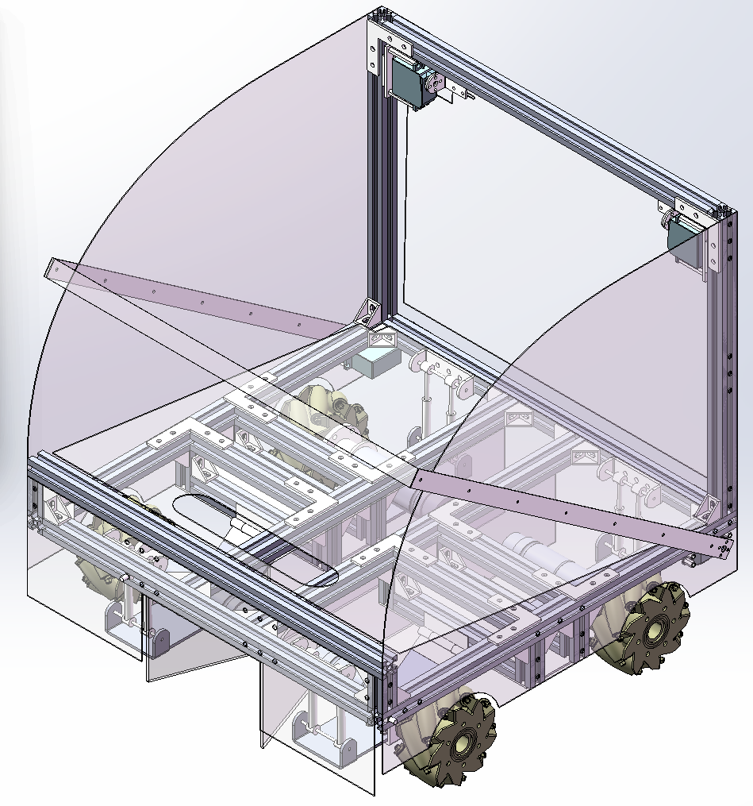
3. Remote-Controlled Multifunctional Ball Picking and Placing Robot
Advisor: Prof. Yingjie Zhang (SCUT)
Design & Modeling

Slide 17
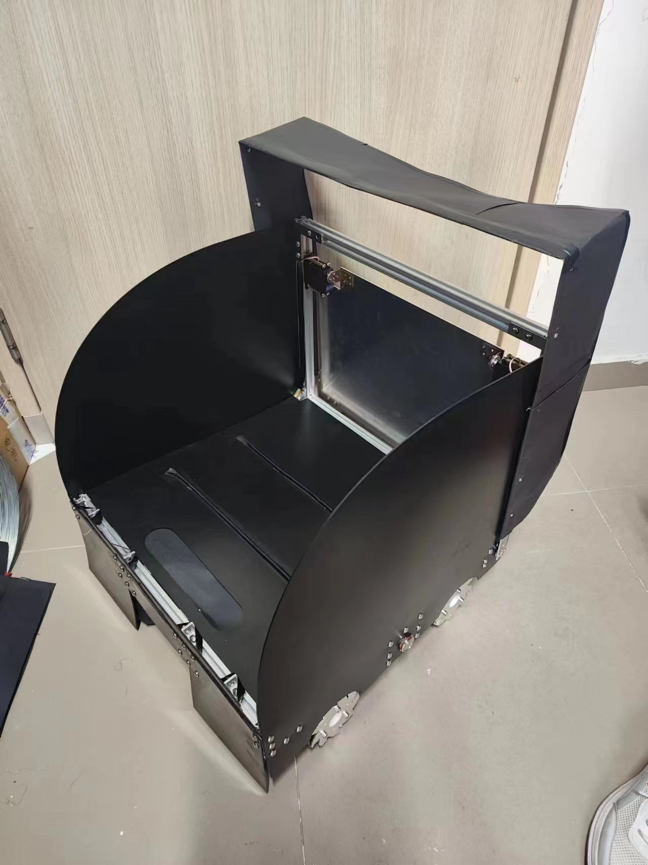
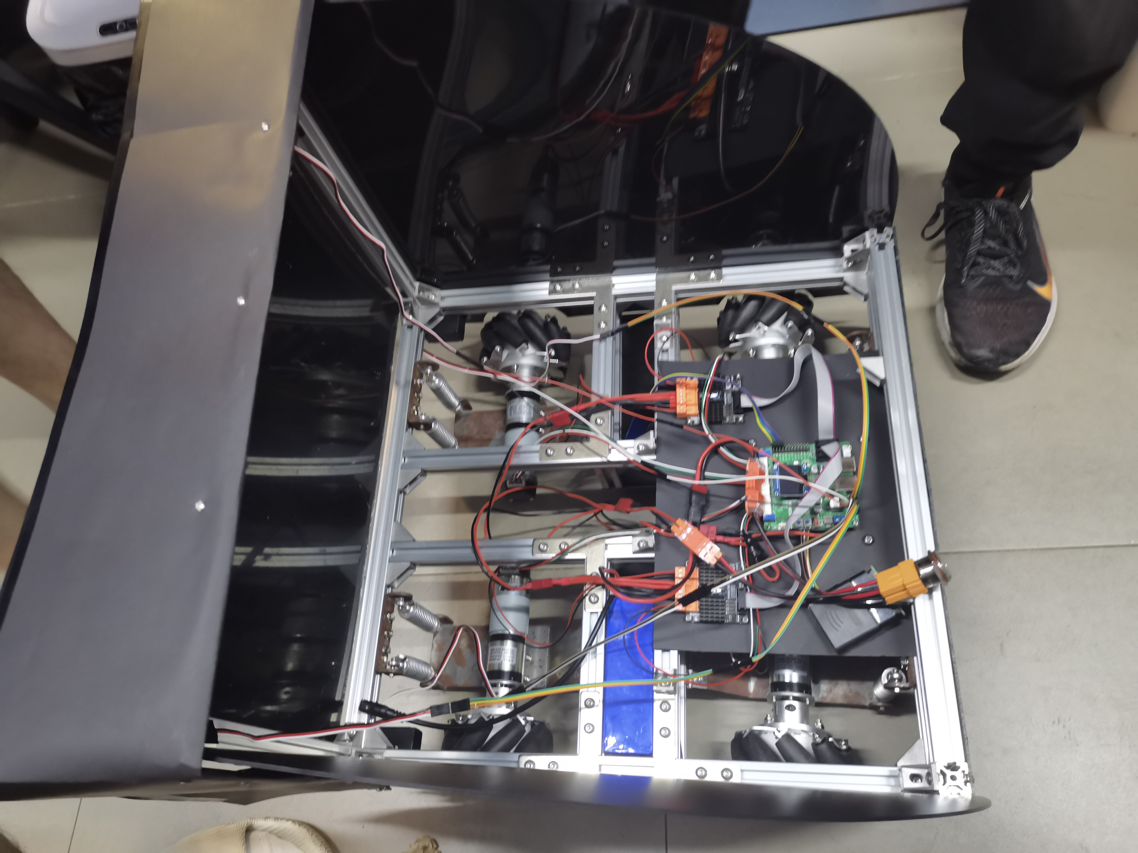
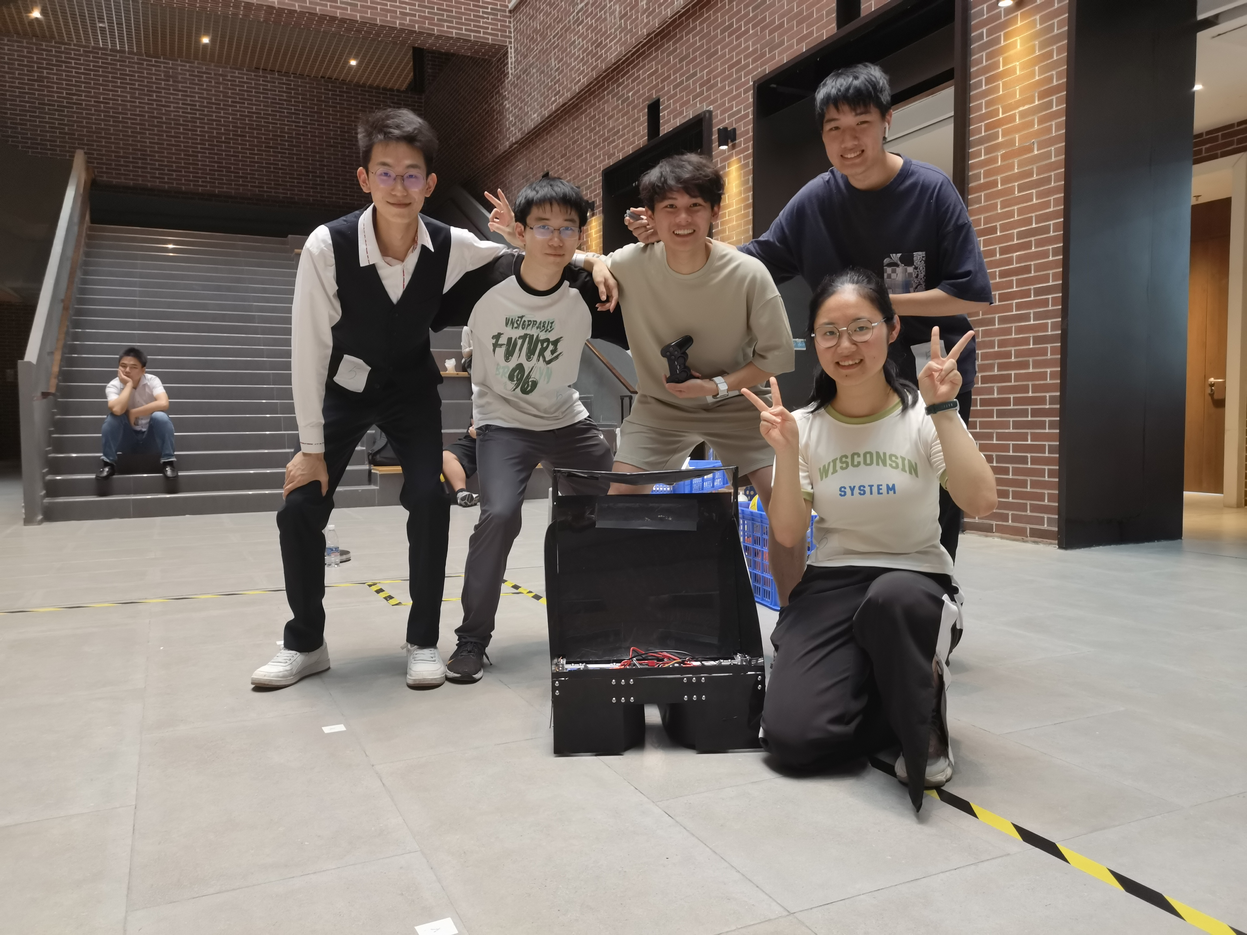
3. Remote-Controlled Multifunctional Ball Picking and Placing Robot
Advisor: Prof. Yingjie Zhang (SCUT)

Slide 18
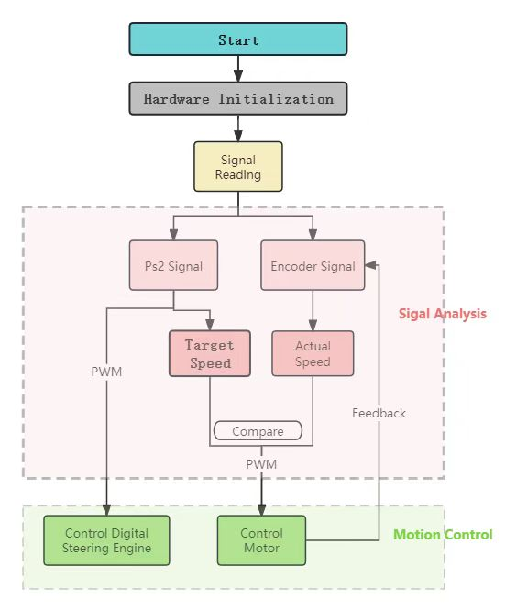
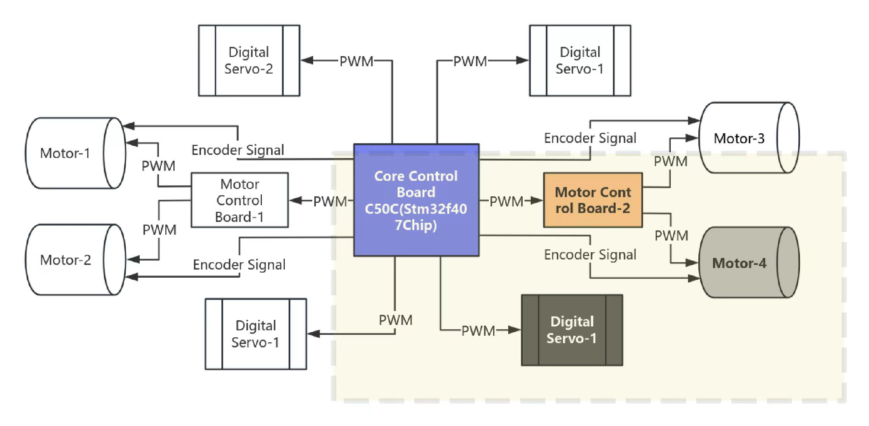
3. Remote-Controlled Multifunctional Ball Picking and Placing Robot
Advisor: Prof. Yingjie Zhang (SCUT)

Slide 19

3. Remote-Controlled Multifunctional Ball Picking and Placing Robot
Advisor: Prof. Yingjie Zhang (SCUT)
Key Outcomes
Acquired expertise in robotic design, code writing, and control methods, paving the way for future development.
Learned how to control motors and servos using PWM, implement speed control with PID, write embedded code, and perform debugging.
Won the silver medal in the ball-picking robot competition held by the school.

Slide 20
4. Bio-mimetic Water Surface Robot with Automatic Obstacle Avoidance
Advisor: Prof. Ye Chen (SCUT), Prof. Glenn Joseph Violett (SCUT)
Goal
Designed a bio-mimetic aquatic robot.
Achieved automatic obstacle avoidance and autonomous navigation from the starting point to docking at the endpoint within the field.

Slide 21
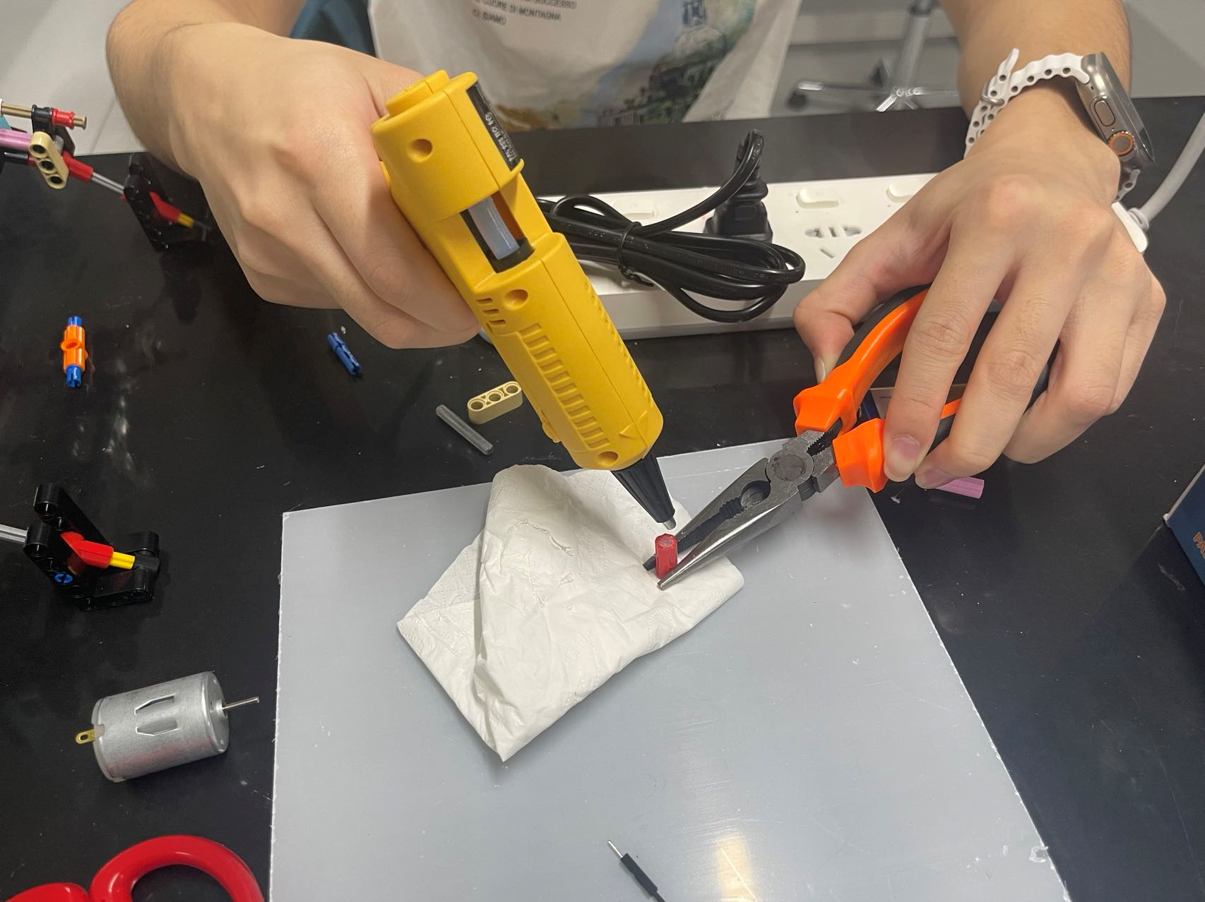
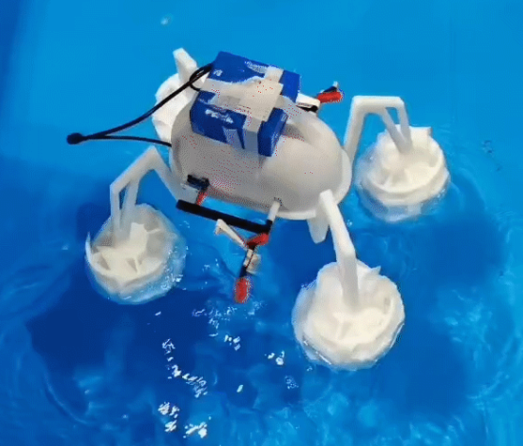
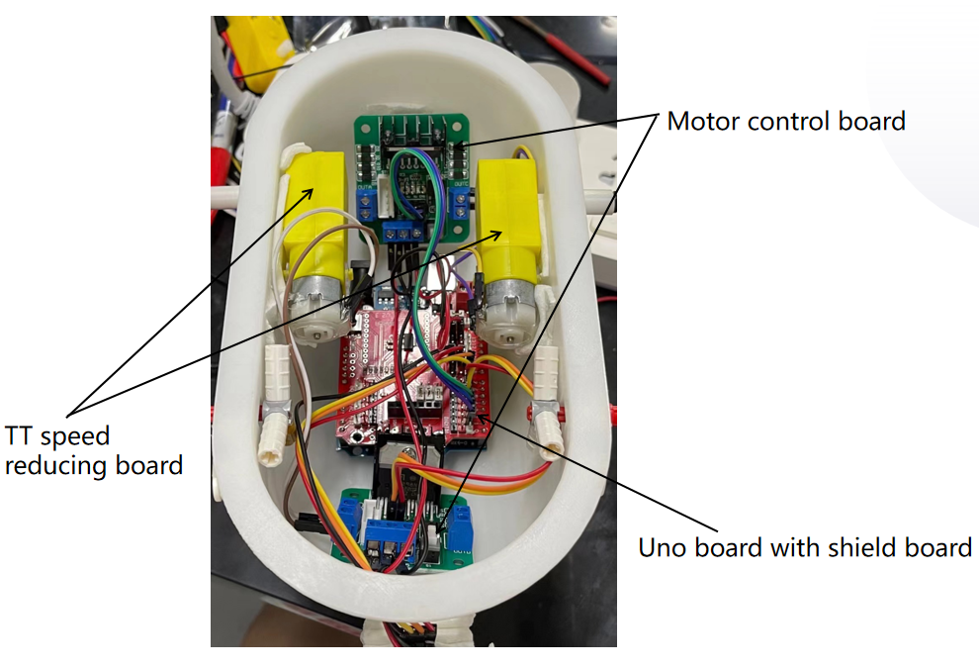
4. Biomimetic Water Surface Robot with Automatic Obstacle Avoidance
Advisor: Prof. Ye Chen (SCUT), Prof. Glenn Joseph Violett (SCUT)

Slide 22
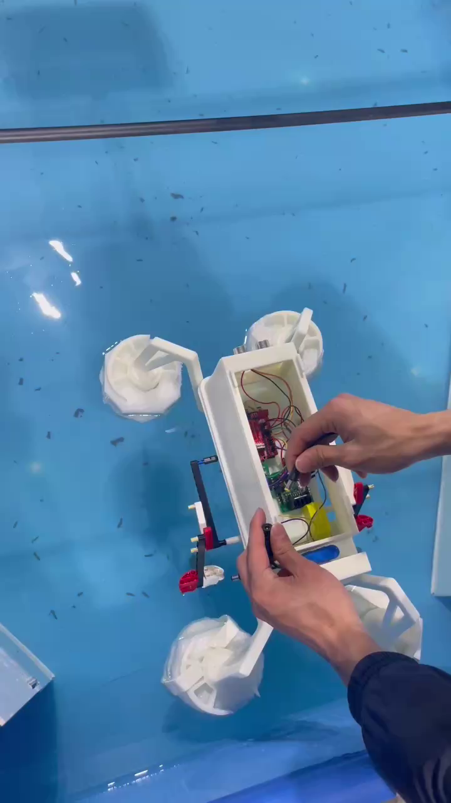
4. Biomimetic Water Surface Robot with Automatic Obstacle Avoidance
Advisor: Prof. Ye Chen (SCUT), Prof. Glenn Joseph Violett (SCUT)
Key Outcomes
Achieved automatic obstacle avoidance and successfully stopped at the designated location.
Gained knowledge in controlling aquatic robots, circuit design, and motor control.

Slide 23
5. Real-Time Robotic Arm Motion Control Algorithm Based on Temporal Logic
Advisor: Prof. Gang Chen (SCUT)
Goal
Model a robotic arm in the ROS2 system and implemented motion simulation.
Apply a temporal logic-based path planning algorithm to the robotic arm.

Slide 24
Thank you!
Ending
Recap for today’s content:
(1)Analysis of Wine Quality Based on Multiple Machine Learning Methods
(2)Embedded Smart Home Terminal Based on Lightweight Machine Learning
(3)Remote-Controlled Multifunctional Ball Picking and Placing Robot
(4)Biomimetic Water Surface Robot with Automatic Obstacle Avoidance
(5)Real-Time Robotic Arm Motion Control Algorithm Based on Temporal Logic

